Slide 1
College Management System Analytics
Analysis by : Niharika Verma
Date : 13th Sep 2025

Slide 2
Introduction
  The College Management System Analytics Project aims to enhance the operational efficiency of a college by analyzing key datasets related to students, faculty, courses, and enrollments.
  Currently, the institution’s data management is fragmented across spreadsheets and manual records, making it difficult to monitor performance, track progress, and make data-driven decisions.

Slide 3
Tables
The college management needs four key datasets
Courses Table – provides details of courses available
Student Table – Students who are enrolled In college
Faculty Table – The Faculty present in the college
Enrollments Table – Enrollment details

Slide 4
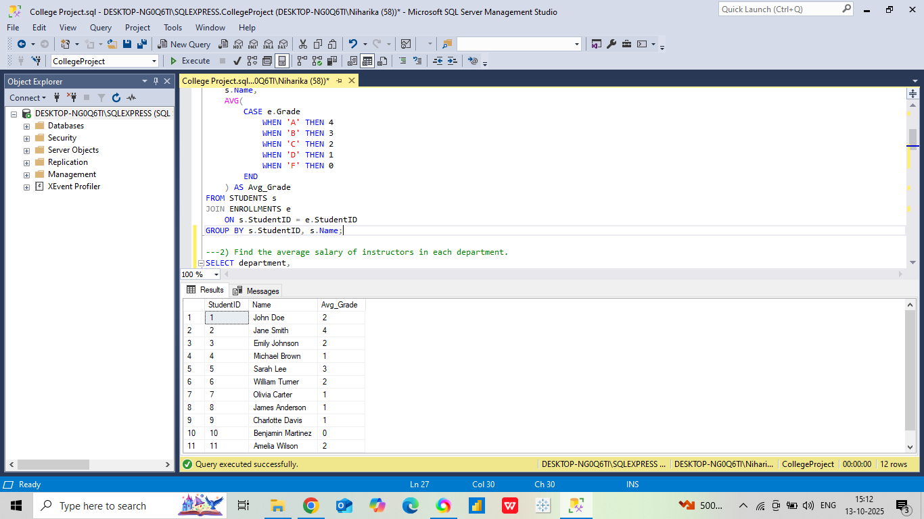
SQL QUERY ANALYSIS
1 . Get the average grade for each student (considering A=4, B=3, C=2, D=1, F=0).

Slide 5
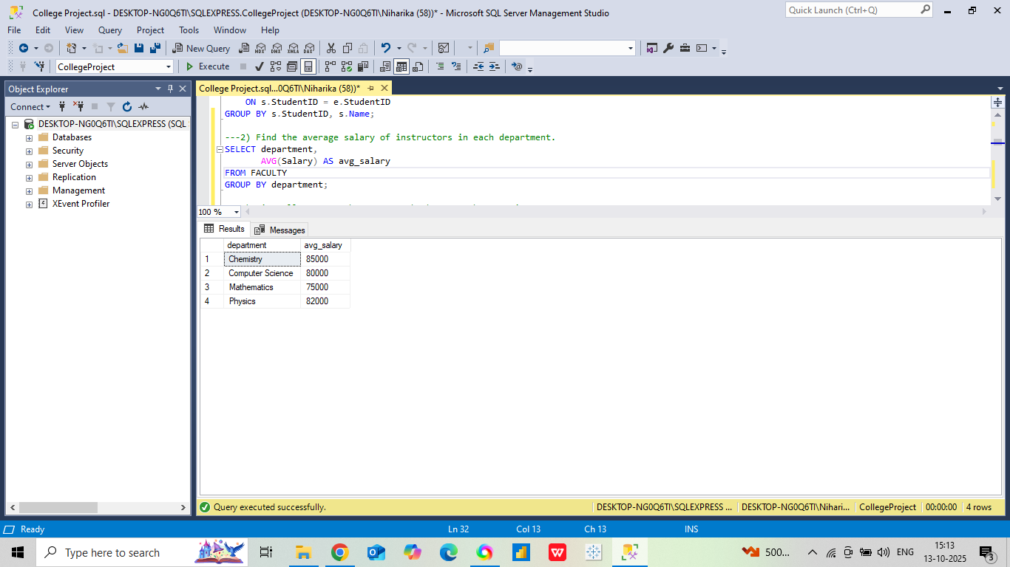
2. Find the average salary of instructors in each department.

Slide 6
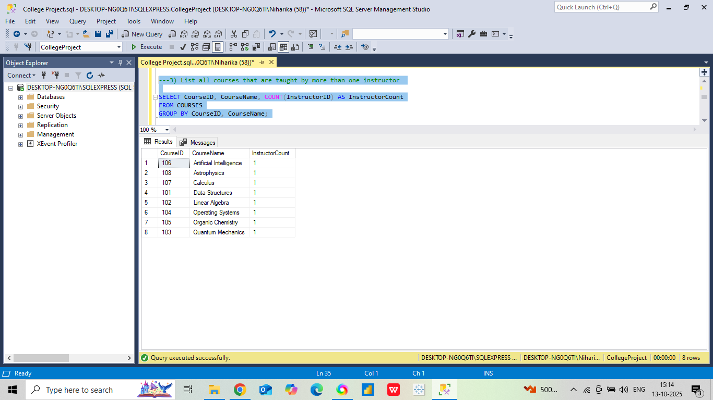
3 . List all courses that are taught by more than one instructor

Slide 7
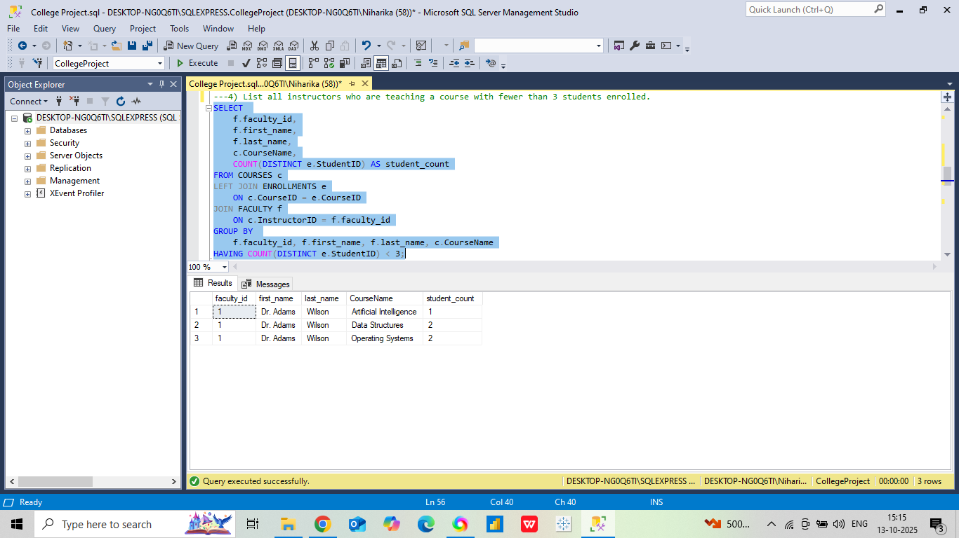
4. List all instructors who are teaching a course with fewer than 3 students enrolled.

Slide 8
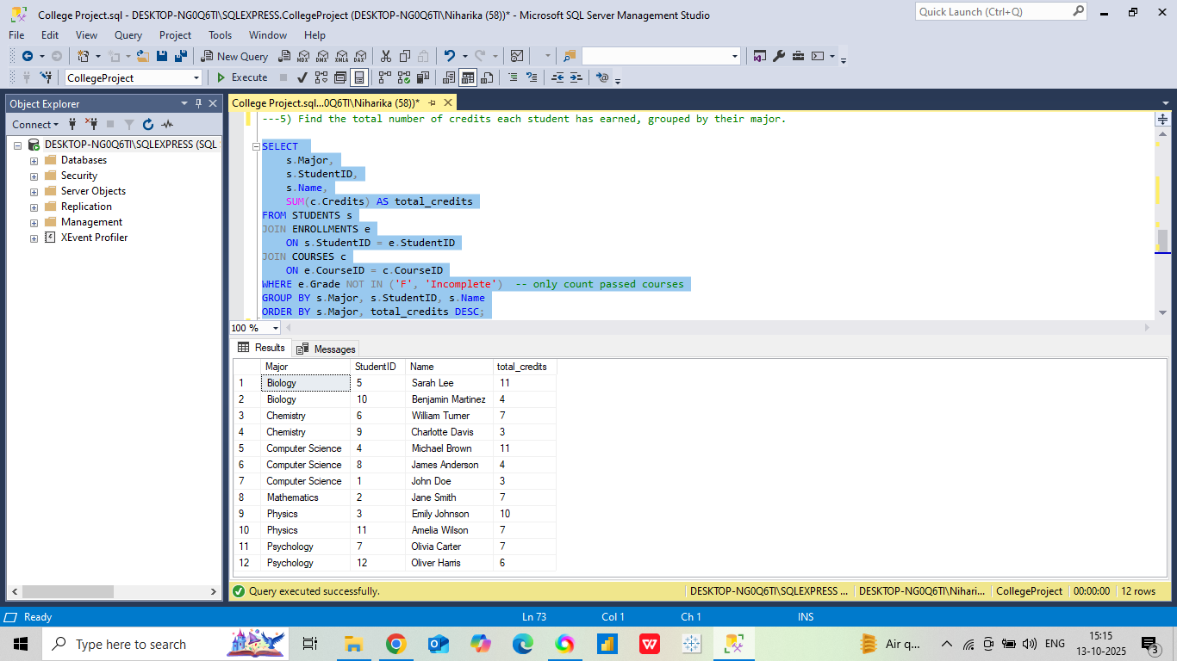
5. Find the total number of credits each student has earned, grouped by their major.

Slide 9
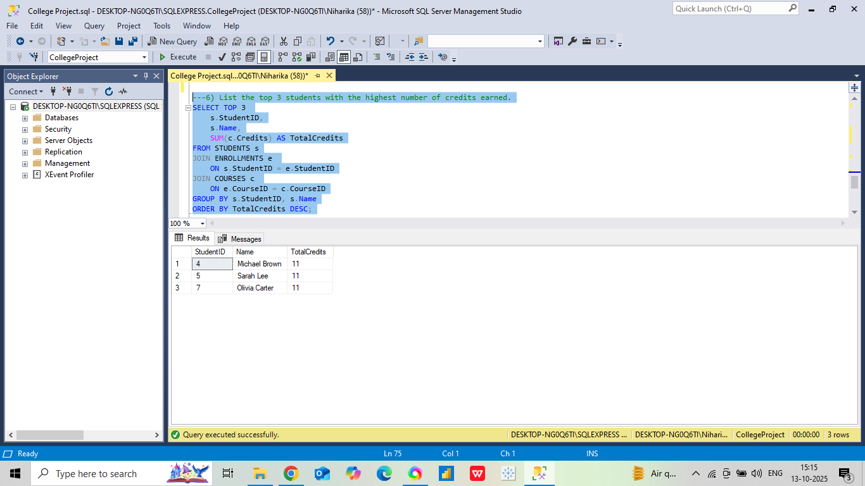
6. List the top 3 students with the highest number of credits earned.

Slide 10
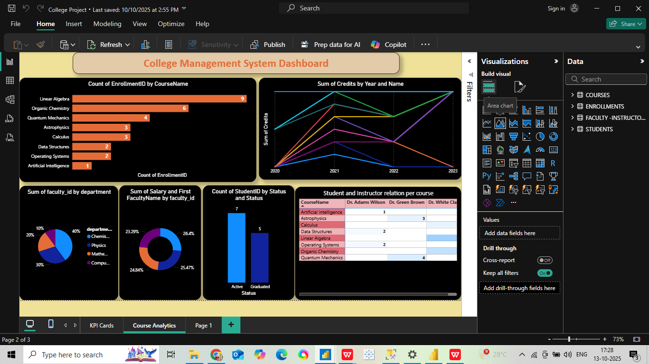
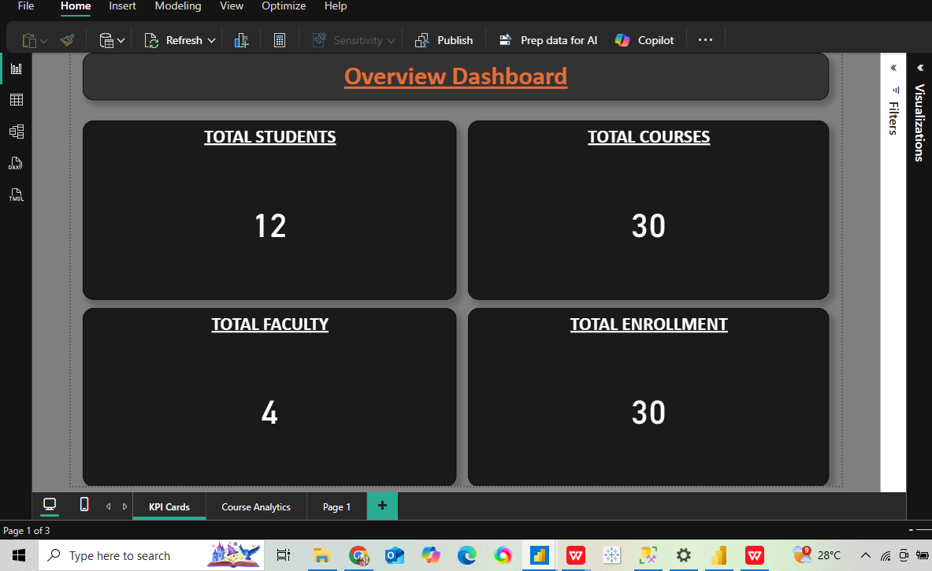
Power BI visualization :

Slide 11
Conclusion:
SQL QUERIES:
Average grades per student to assess academic performance.
Instructor workload and course distribution to optimize teaching resources.
Total credits earned per student and department-level summaries to evaluate progress.
Top-performing students and instructor salary averages to identify performance patterns.
POWER BI REPORT:
Course-wise student enrollment trends.
Department-wise faculty distribution and salary comparisons.
Student progression through credit accumulation over time.
Active vs. graduated student proportions.

Slide 12



THANK YOU

